Slide 1


Slide 2
Affinity Propagation: It is different from other clustering algorithms as it does not require to specify the number of clusters. In this, each data point sends a message between the pair of data points until convergence. It has O(N²T) time complexity, which is the main drawback of this algorithm.

Slide 3
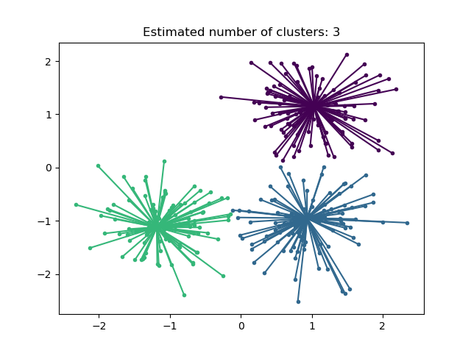

Slide 4
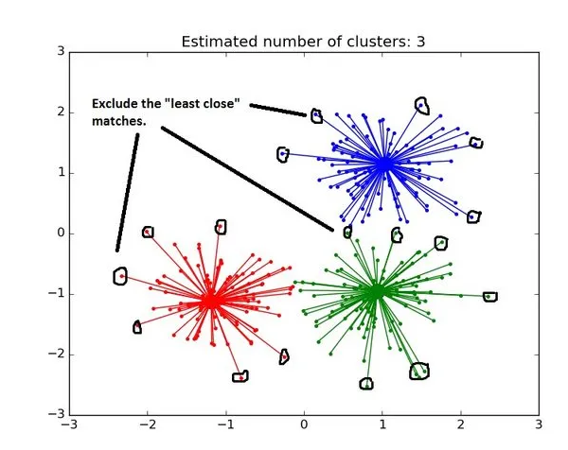

Slide 5
